Slide 1
Tail risk contagion in international energy market
Group 9:
Aryan Srivastava 2022A1PS1279G
Pratik Ghosh 2022A40148G
Prabhav Srivastava 2022A4PS1523G
Ankita Saha 2022A8PS0034G
Garvit Bhardwaj 2022A4PS1220G
Sri Ram Bhardwaj 2022A4PS1244G
Kshitij Arora 2022A8PS0022G

Slide 2
ABSTRACT
The study investigates tail risk contagion in international energy markets, focusing on the interconnectedness between green bonds, traditional energy markets, and sectoral investments. Using advanced econometric models such as ARMA-EGARCH-Skew-t and quantile time-frequency spillover frameworks, the research examines how extreme market shocks propagate through these markets. The findings highlight the central role of traditional energy markets as risk transmitters and the dual behavior of green bonds—acting as stabilizers during downturns but becoming risk absorbers during market upswings. This analysis provides critical insights for policymakers and investors in managing systemic risks and promoting sustainable energy transitions.
01
Problem Statement:
Understanding how extreme market shocks (tail risks) propagate between green bonds, traditional energy markets, and sectoral investments.
02
Significance:
Critical for managing systemic risks, promoting sustainable energy transitions, and aiding portfolio diversification for investors and policymakers.

Slide 3



3 KEY LITERATURE REVIEWS
Green Bonds & Systemic Risks
Oil Prices & Clean Energy Markets
Quantile-Based Approaches
The advanced writings in literature have, however, included more advanced econometric techniques like quantile VAR and frequency domain. According to Gong et al. (2023), through quantile time-frequency volatility spillover analysis, it is possible to deduce that the degree of the contagion of the tail risk across the energy markets rises during the occurrence of either market tail events. It also noted that clean energy markets, in fact, act as sink buyers for tail risk from the conventional energy sectors especially in the long-term perspective. Recall that Balcilar et al. (2019) and Lee and Zeng (2011) used quantile regression which enabled them to determine the non-linear and asymmetric link between oil prices and stock markets depending on the conditions of the market. It was further revealed that explosive negative oil price shocks were favorable for the U. S. stock market more so under conditions of high market performance even though the positive oil price shocks did not produce a very robust outcome.
Green bonds have thus proved to be very relevant tools in channelling funds to sustainable initiatives with overall expansion in both Chinese and U.S markets. There is also literature done on the correlation of green bonds with other assets such as energy, stock and regular bonds. Both the study done by Tang and Zhang (2020) points out that green bonds have connections to systemic risks and the connections are strong to the traditional markets. Further, studies reveal the volatility spillovers between crude oil, energy, and green bonds have an impact on the market performance.
The relationship between oil prices and clean energy markets has been a focal point of research. Henriques and Sadorsky (2008) pioneered the examination of Granger causality between oil prices and renewable energy stock prices, discovering that both technology stock prices and oil prices significantly affect renewable energy companies' stock prices. In the subsequent works by Kumar et al., (2010), Huang et al., (2011) and Bondia et al., (2016) similar associations have been also found by employing other kinds of econometric techniques. Reboredo (2015) and Pham (2016) provided evidence that the volatility in oil price is able to affect clean energy stock markets. However, Elie et al. (2019) highlighted that clean energy stocks have loose connection with the traditional energy sectors in the normal market situation but become stronger in the presence of an economic shock.

Slide 4
OBJECTIVE
The study investigates tail risk contagion in international energy markets, focusing on the interconnectedness between green bonds, traditional energy markets, and sectoral investments. Using advanced econometric models such as ARMA-EGARCH-Skew-t and quantile time-frequency spillover frameworks, the research examines how extreme market shocks propagate through these markets. The findings highlight the central role of traditional energy markets as risk transmitters and the dual behavior of green bonds—acting as stabilizers during downturns but becoming risk absorbers during market upswings. This analysis provides critical insights for policymakers and investors in managing systemic risks and promoting sustainable energy transitions.
01
Research Gap:
Restricted focus on extreme market conditions: Most of the current research work mostly
employs the simple linear regression models and are basically confined to the overall
relationship or average condition of the market. Currently, there is a lack of literature that focus on tail risks and high volatility in the market and their connection with green bonds and multiple sectors.
02
Key Questions:
How do tail risks propagate across green and traditional energy markets
Which sectors are net risk exporters/importers?

Slide 5


RESEARCH METHODOLOGY
ARMA-EGARCH-Skew-t Model
Quantile Time-Frequency Spillover Framework
Prior to applying the quantile time-frequency spillover framework to the analysis of tail risk spillovers, the volatility of energy markets must first be estimated, including tail risk factors. The conventional GARCH model captures long memory and heteroscedasticity in return series, but it does not adequately capture leptokurtic and asymmetric properties. This asymmetry of volatility in asset returns is captured using the asymmetric EGARCH model proposed by Nelson (1991). Relying on the asymmetric EGARCH framework in the model employed in this paper, the ARMA-EGARCH-Skew-t model is used to capture the asymmetric characteristics of return distribution in the international energy market commodity as well as model the dynamic changing in the tail risk spillovers in the international energy market and hedging effects especially in extreme events. The model is expressed as follows: $$r_{t}=φ_{0}+\sum_{j=1}^{p}{ }φ_{j}r_{t−j}+ε_{t}+\sum_{i=1}^{q}{ }ε_{t−i}$$
$$ln⁡σ_{t}^{2}=ω+\sum_{i=1}^{q}{ }α_{i}g(η_{t−i})+\sum_{j=1}^{p}{ }β_{j}ln⁡σ_{t−j}^{2}$$
$$g(η_{t})=θη_{t}+γ(|η_{t}|−E(|η_{t}|))$$
$$ε_{t}=σ_{t}η_{t}$$
where {αi}(i = 1,2, …,q, q > 0), {βj}(j = 1,2, …,p, p ≥ 0) are non-random real scalar sequences, ω > 0, g(•) satisfies Et-1(g(ηt)) = 0. When θ < 0, ηt < 0, the effect of the volatility caused by negative disturbances is greater than the effects of positive disturbances when ηt > 0.
ECONOMETRIC TOOLS/TECHNIQUES
Following analysis of the energy market volatility measured by the tail risk factor, the paper examines the spillover effects of tail risk in the international energy market for various shock sizes and different time horizons based on the generalized forecast error variance decomposition according to the QVAR model suggested by Chatziantoniou et al. 2022a. This approach utilizes rolling windows for dynamic total tail risk spillover and directional spillover estimates. Using a variety of quantiles of volatility in the energy market captures shock magnitude. The greater the magnitude of the shock felt, the greater the change in uncertainty. Of these three, the conditional median is a normal state, the 0.05 conditional quantile marks the extreme declining state, and the 0.95 conditional quantile marks the extreme rising state. The N-dimensional QVAR model under the time domain can be summarized as follows:
$x_{t}=μ_{t}(τ)+Φ_{1}(τ)x_{t−1}+Φ_{2}(τ)x_{t−2}+⋯+Φ_{p}(τ)x_{t−p}+u_{t}(τ)$ (3)
where xt and xt-i,i = 1, …,p denotes the N × 1-dimensional endogenous variable vector, p represents the lag order. According to the AIC criteria, the lag of the volatility is determined to be 1. τ between [0,1] indicates the level of quantile. μt(τ) is the mean value vector of N × 1-dimensional, Φj(τ) is the coefficient matrix of N × N dimensions, and ut(τ) is the N × 1-dimensional error vector. It can therefore be transformed into an order infinity quantile vector moving average QVMA process.
$x_{t}=μ(τ)+\sum_{p=1}^{∞}{ }Ψ_{i}(τ)u_{t−i}$

Slide 6
RESEARCH METHODOLOGY
Data Sources:
MSCI Green Bond Index: Tracks the performance of green bonds used to finance sustainable projects globally.
S&P Green Bond Index: Provides a broad measure of green bonds issued to fund environmentally beneficial projects.
S&P 500 Sectoral Indices: Covers traditional and sector-specific indices, including:
Energy (SPNY)
Financials (SPSY)
Industrials (SPLRCI)
Healthcare (SPXHC)
Utilities (SPLRCU)
Information Technology (SPLRCT)
US Economic Policy Uncertainty Index: Evaluates uncertainty in U.S. government policy impacting investments and markets.
Period of Study:
Janaury 2015 to December 2024
The exact time period analyzed in the report spans from January 2015 to December 2023. This period captures significant market fluctuations and events, including the impacts of the COVID-19 pandemic and geopolitical tensions such as the Russia-Ukraine conflict, providing a comprehensive view of systemic risk and tail risk contagion in international energy and green bond markets.

Slide 7
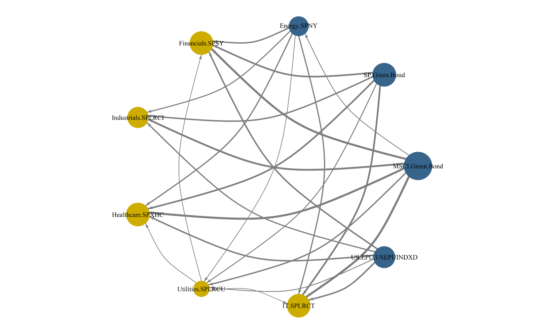
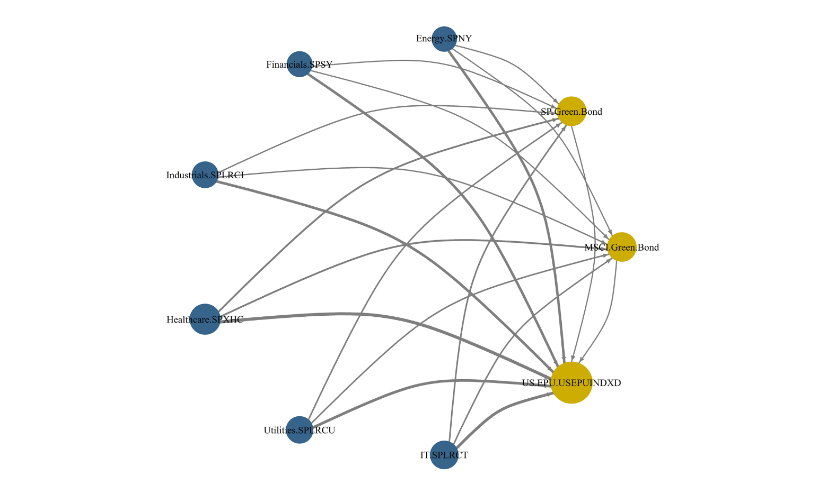
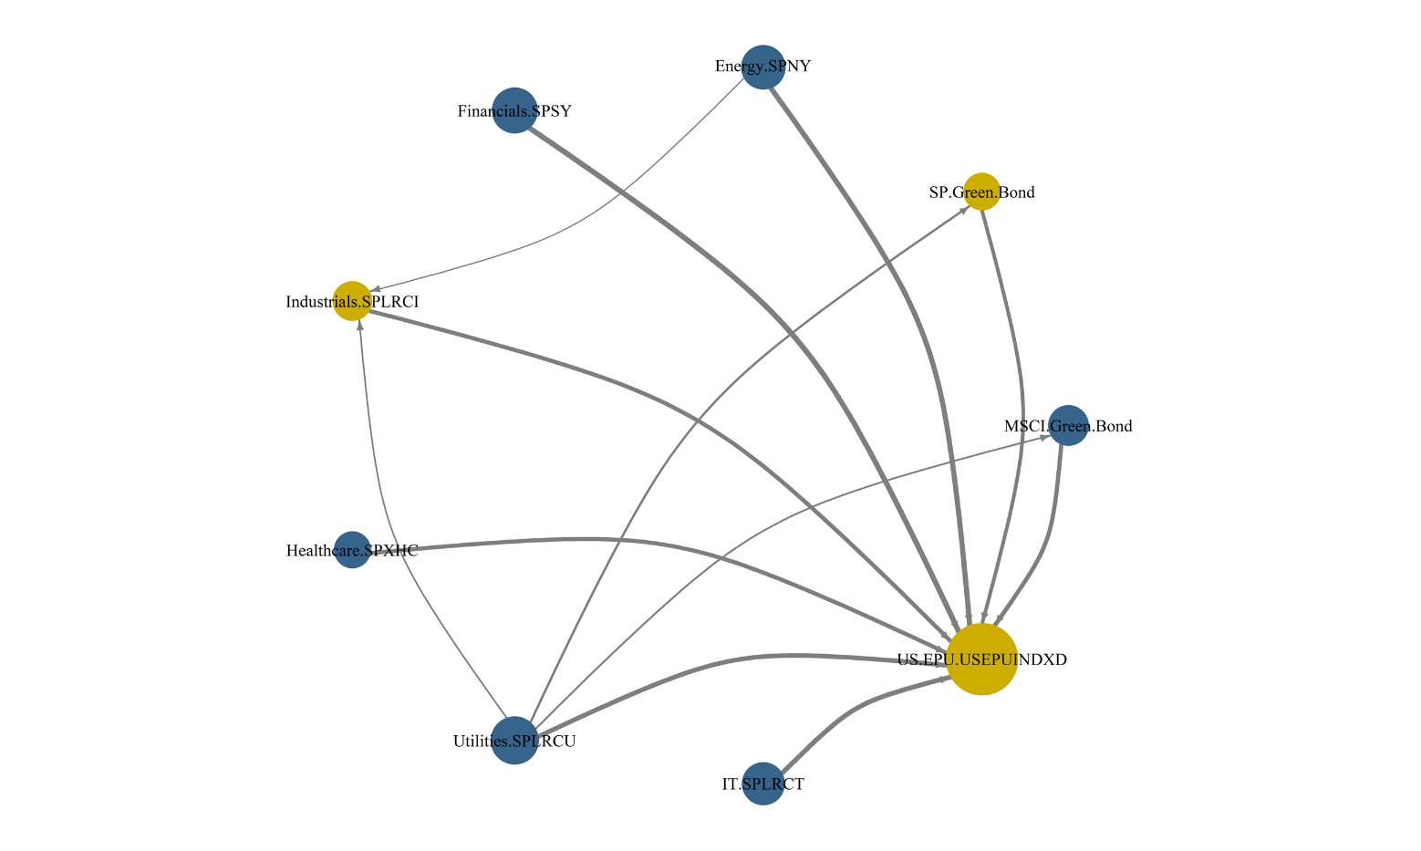
EMPERICAL RESULTS/MAJOR FINDINGS
Static Spillover Effects
Normal Market Conditions
Green Bonds (MSCI and SP) dominate as risk transmitters with outward spillover percentages (TO) of 87.71% and 82.31%.
Utilities SPLRCU exhibits the highest inward spillover (FROM: 91.92%), reflecting dependency on external shocks.
Energy SPNY and Industrials SPLRCI are net risk exporters (NET: 9.53%, 11.33%).
The Total Connectedness Index (TCI) is high, underscoring interdependence across sectors.
Extreme Falling Markets:
Spillover effects are more concentrated, with Energy SPNY and Financials SPSY emerging as dominant risk transmitters (TO: 77.94%, 93.9%).
Green Bonds become net risk absorbers (NET: -11.89, -12.16), highlighting their vulnerability during downturns.
The Total Spillover Index (TSI) is 69.86%, emphasizing substantial but not overwhelming interconnectedness.
Extreme Rising Markets
Risk contagion is significantly heightened (TSI: 88.60%), with reduced self-containment across sectors.
Energy SPNY and Utilities SPLRCU lead risk transmission, with TO values exceeding 95%.
Green Bonds continue to act as net risk importers during booms, highlighting asymmetric dependencies.

Slide 8
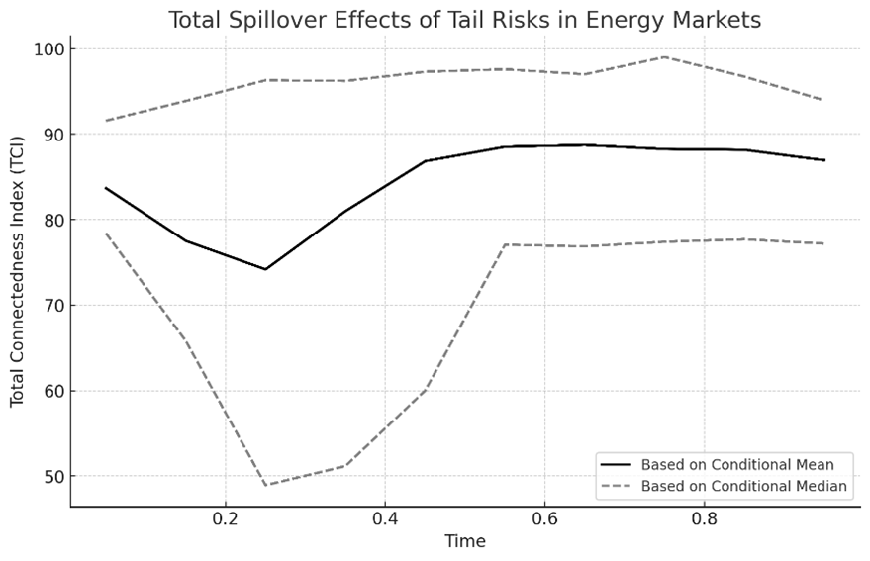
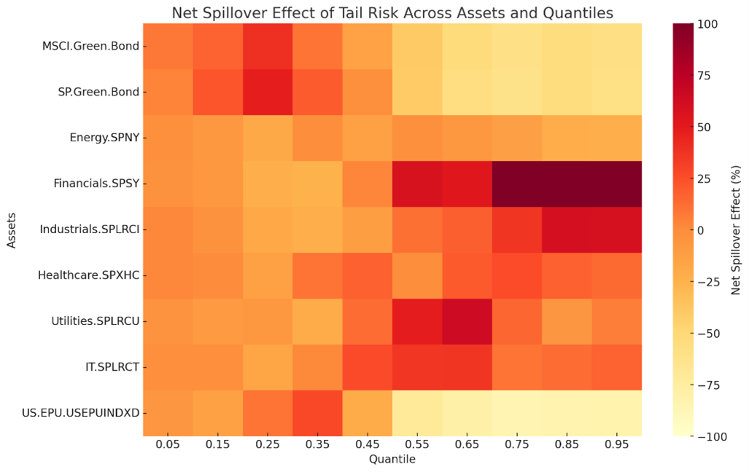
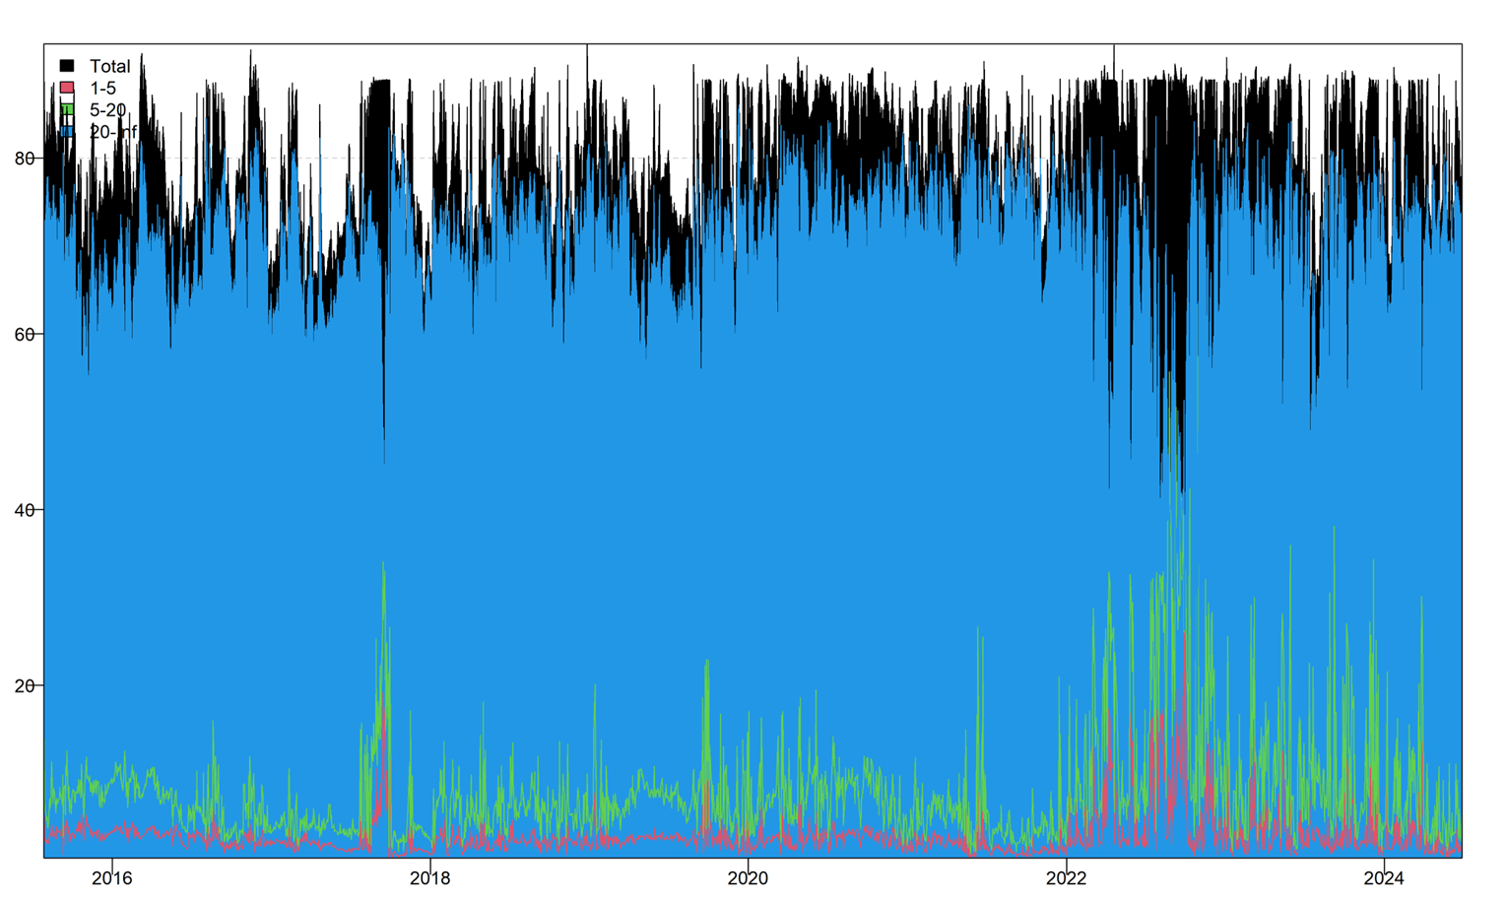
EMPERICAL RESULTS/MAJOR FINDINGS
Dynamic Spillover Effects of Tail Risk in International Energy Markets
Total Spillover Effects (TCI):
Range: 50%-90%, reflecting high interconnectedness in energy markets.
Trends: Spikes indicate heightened systemic risk due to external shocks.
Methods:
Conditional Mean: Captures broader fluctuations, sensitive to outliers.
Conditional Median: Filters out extremes for stability.
Net Spillovers Across Quantiles (Heatmap):
Low Quantiles (0.05-0.25): Financials dominate spillovers during downturns.
Medium Quantiles (0.5-0.75): Energy and Financials lead during stable markets.
High Quantiles (0.85-0.95): Peak spillovers during exuberance, driven by volatility.
Green Bonds: Exhibit low spillovers, acting as stabilizers.

Slide 9
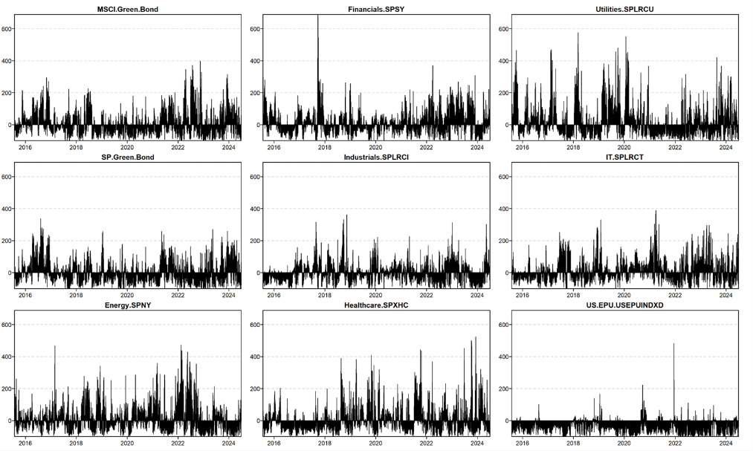
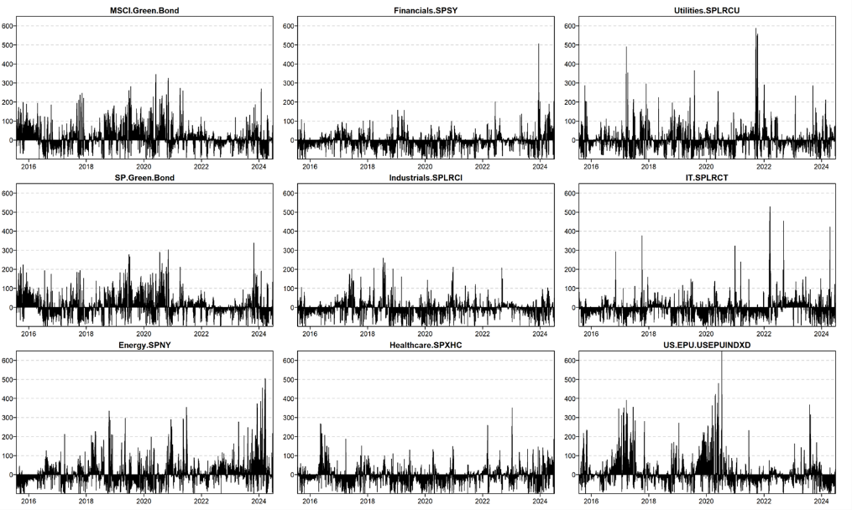
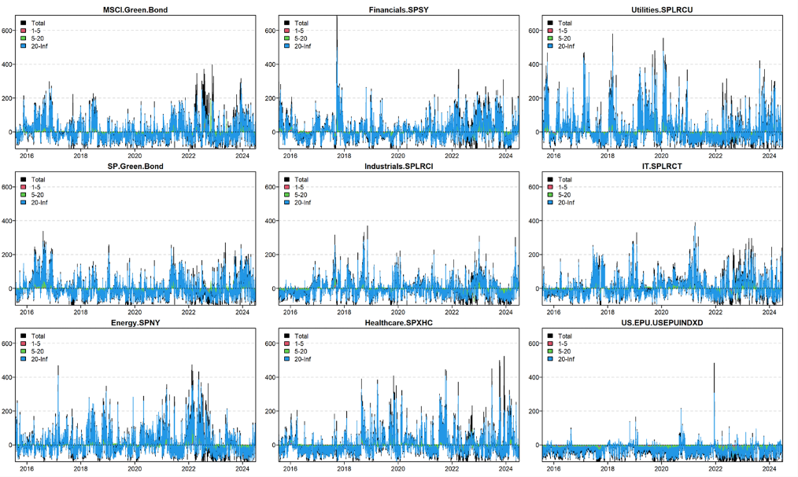
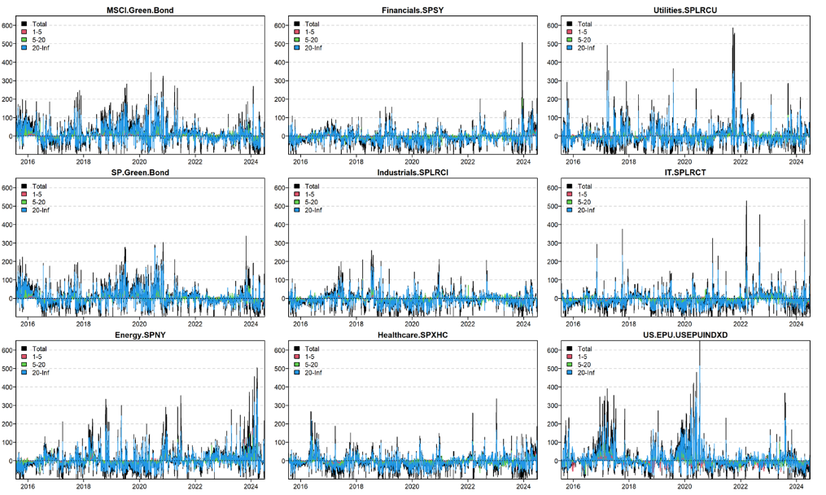
EMPERICAL RESULTS/MAJOR FINDINGS
Directional Spillover of Tail Risk in International Energy Markets
Spillover Dynamics Across Sectors:
High Spillovers: Energy SPNY and Financials SPSY dominate risk propagation, especially during crises (e.g., COVID-19, geopolitical tensions).
Resilient Assets: Green Bonds (SP & MSCI) show low, stable spillovers, acting as effective hedging tools.
Moderate Spillovers: Utilities SPLRCU and Healthcare SPXHC reflect defensive characteristics, partially insulated from broader shocks.
Frequency-Domain Spillovers:
Long-term (20+ days): Dominates systemic risk, led by Energy SPNY, Financials SPSY, and Industrials SPLRCI.
Short & Medium-term: Financials SPSY shows significant activity during rapid adjustments, while green bonds remain stable across all horizons.
Sector Evolution:
Traditional sectors (Energy SPNY, Financials SPSY): Persistent high spillovers, key drivers of contagion.
Green Bonds: Resilience across timeframes, promoting stability and carbon neutrality goals.
Defensive Sectors: Utilities SPLRCU and Healthcare SPXHC maintain moderate, stable spillovers, enhancing portfolio diversification.

Slide 10
POLICY IMPLICATIONS
Develop regulatory frameworks for diversification
Leverage green finance for sustainable energy transitions.
CONCLUSION
This study provides an in-depth analysis of tail risk contagion and volatility spillovers in international energy markets, focusing on the interactions between green bonds, traditional energy sectors, and other sectoral indices. Employing advanced econometric techniques, including the ARMA-EGARCH-Skew-t model and the quantile time-frequency spillover framework, the research highlights the complexities of risk propagation under various market conditions.
In conclusion, this research sheds light on the evolving dynamics of risk spillovers in energy markets, emphasizing the critical role of green finance in fostering market resilience. By combining advanced methodologies with detailed empirical analysis, the study provides actionable insights for navigating the complexities of a rapidly transforming energy and financial landscape. Future research should explore the influence of emerging technologies and policy innovations on these dynamics, ensuring a comprehensive understanding of risk propagation in a world increasingly oriented toward sustainability.

Slide 11
THANK YOU

